Slide 1
Fitness Management System

Slide 2
Introduction
A fitness app is an application that can be downloaded on any mobile device and used anywhere to get fit.
These apps performs various functions such as fitness goals, tracking calorie intake, water tracking, giving ideas for workout and sharing progess on social media.
The app tracks how often you stand, how much you move, and how many minutes of exercise you do.
The goal is to sit less, move more, and get more exercise by completing the tasks everyday.
They can be used as a platform to healthy habits with personalized workouts, healthy eating habits, fitness advices, cholesterol regulation and sleep tracking.

Slide 3

Operating System in Server Side (Windows)
Microsoft Windows, commonly referred to as Windows, is a group of several proprietary graphical operating system families, all of which are developed and marketed by Microsoft.
Advantages of Windows:
Ease of use
Availability of software
Backwards Compatibility
Support for New Hardware

Slide 4

Operating System in Client Side
Android OS is the operating system used for the given application.
Android Inc. was founded by Rich Miner, Nick Sears, Chris White and Andy Rubin in 2003.
The first successful commercial version Android 1.0, was released in September, 2008.
Android is a mobile operating system based on a modified version of the Linux kernel and other open source software.
Worldwide, as of 2020, there are 2.8 billion people who use Android as their operating system.

Slide 5
Operating System in Client Side
Advantages of OS:
Android is an open-source platform allowing UI customization.
Supports cloud storage enabling sync of devices with Google account.
Continual improvement & removal of old features.
Supports 3rd party widget & information display on screen.
It allows for greater freedom for making applications without much limit.
It adds versatility to the devices in which Android is run on.

Slide 6
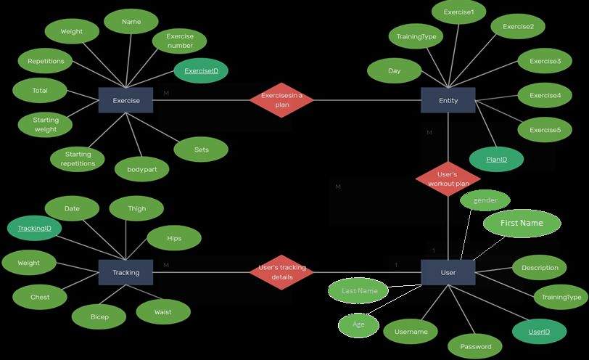
ER Diagram of DBMS

Slide 7
Business Rules
Business rules are statements that imposes some form of constraint on a specific aspect of the database, such as the elements within a field specification for a particular field or the characteristics of a given relationship.
Here are some business rules which are followed by the database we created:
Each user of the application can have multiple workout plans but it is individual for each user.
The age limit of the user is 13 and above. Users below the age of 13 must be check off the parental supervision box.
The UserID, PlanID, ExerciseID, and TrackingID will be unique to all the users.

Slide 8
Business Rules
The password of the user must consist of letters, uppercase, numbers and miscellaneous characters.
The monitoring of thigh, hips, biceps, weight etc. is done regularly.
Full use of the service is dependent on the upon your computer with adequate software or a supported mobile service with internet access.

Slide 9
Queries for Database
These are some queries that DBMS can answer for the application:
A query to list all the details of the participants.
A query to list the Username of the user whose gender is Male.
A query to list the UserID, gender and last name of the users whose UserID is between 10000 and 25000.
A query to list the UserID of the users whose gender is male and TrainingType is medium and; gender is female and description is thin.
A query to list the firstname and lastname of the users who have signed at ages below 13.
A query to list the age, gender and UserID of the users whose TrainingType is pro and description is fat.

Slide 10
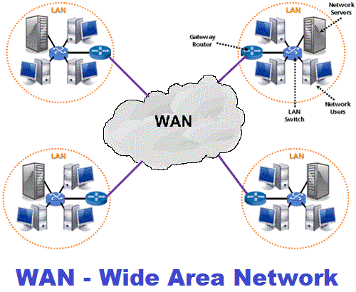
Server Side Network
Benefits of WAN:
Covers larger geographical area.
Allows sharing of resources and application softwares among distributed workstations or users.
Provide the facility of sharing the data to all connected devices in a network.
Organizations can form their global integrated network through WAN.
It has higher bandwidth than normal bandwidth making transfer of files easier.

Slide 11
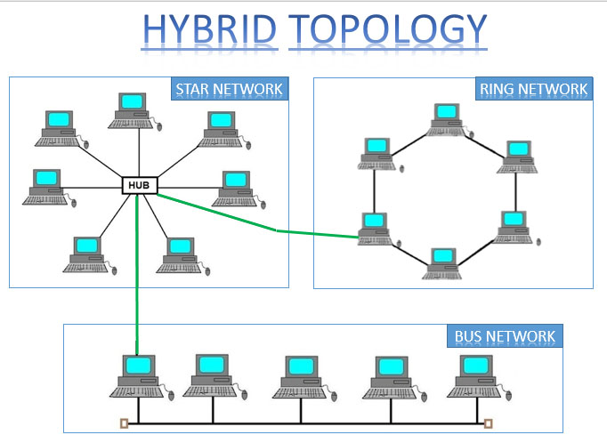
Network Topology in Server Side
Benefits of Hybrid Topology:
Combines the benefits of different types of topologies in one topology.
Can be modified as per requirement.
Extremely flexible.
Error detecting and troubleshooting is easy.
Handles large volumes of traffic.
Very effective in large networks.

Slide 12
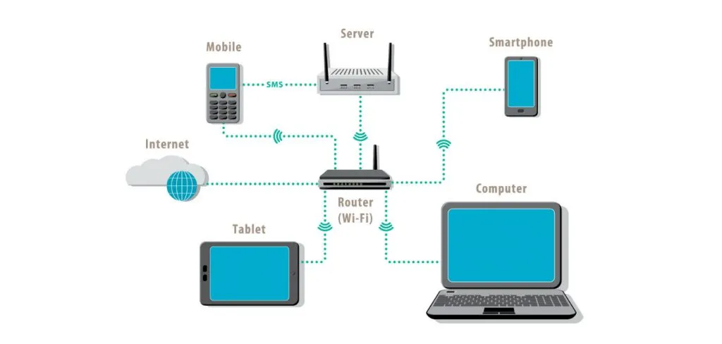
Client Side Network
Benefits of LAN:
Easy to use the same software in a number of computers connected to a network.
Data and messages can easily be shared with the other computer connected to the network.
The data of all network users can be stored on a hard disk of the central/server computer.
Since data is stored on the server computer, it will be easy to manage data at only one place and the data will be more secure as well.

Slide 13
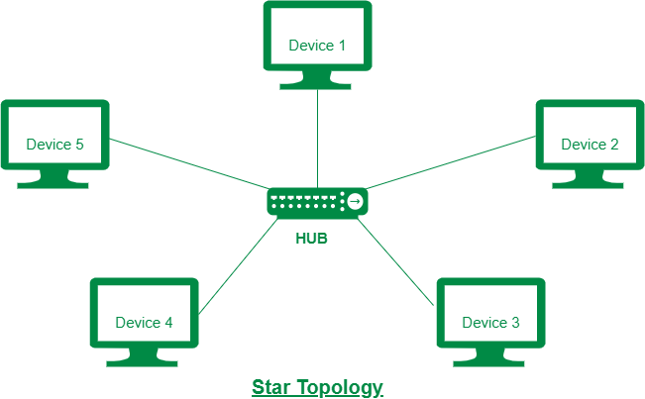
Network Topology in Client Side
Benefits of Star Topology:
Failure of one node does not show impact on other nodes.
Addition and removal of nodes can be done without influencing the rest of the network.
The length of the network can be extended by adding multiple stars to the server.
Probability of data collisions is very less.
When there is any cut cable, the impact is shown only on one node.

Slide 14
Summary of the Application
This application is for fitness daily tracking and monitoring.
This application uses Android operating system as a client side OS.
This application uses its own device and mobile or computer, so customers can control the tracking and monitoring.
This application stores the users name, age, body type, weight, height, etc. and is constantly monitored.
This application uses a client - server model as a Networking model.
We use a star topology in the client side and a hybrid topology in the server side of the OS.
The application is meant to be user friendly, easy to use but also to to be used with precaution as it the users health that is on the line.

